Slide 1

Concrete crack detection system-phase 2

Slide 2
Compiling the model
After the model is created, it is compiled using the adam optimizer, one of the most popular optimization algorithm. Additionally, the loss function type is specified as categorical cross entropy which is used for multi class classification, binary cross entropy can also be used as the loss function. Lastly, the metrics is specified as accuracy.

Slide 3
Compiling the model
To compile our model, the following parameters are needed: Optimizers, loss function and metrics
Optimizer: Adam optimizers perform the best on average compared to other optimizers.
Loss function: The loss function used to compile our model is categorical cross entropy. It is used as a loss function for multi class classification model. That is when we have two or more output labels.
Metrics: The metrics is accuracy

Slide 4
Training the model
The model is trained with keras’ fit() function. The model trains for 15 epochs. The fit() function will return a history object; By storing the result of the function in a history, it is used to plot the accuracy and the loss function plots between the training and validation which will help to visualize our model's performance visually.

Slide 5
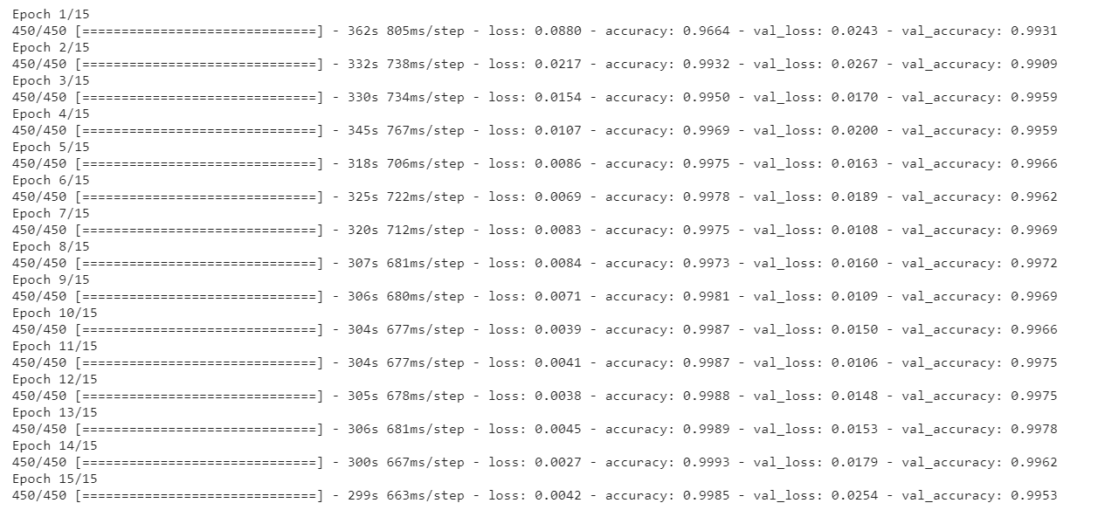
Training the model
To train our model, the following parameters are needed: number of epochs, validation data and train data
Epoch: An epoch represents one training step
Figure 1: model being trained
From the figure above, after 15 epochs a train accuracy of 99.85% was obtained

Slide 6
Model evaluation on test accuracy
Accuracy: 99.66% , Loss: 1.40%
An accuracy of 99.66% looks impressive!

Slide 7
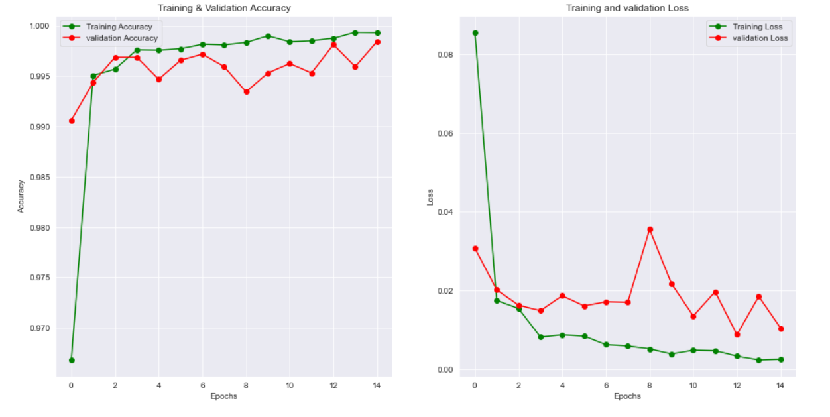
Visualizing the accuracy and loss of my model
Putting my model evaluation into perspective by plotting the accuracy and loss plots of the training and validation data
Figure 2: Plots representing the accuracies and losses of the train and validation data

Slide 8
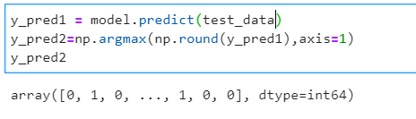
Predicting labels
Model test data prediction gives us floating-point values. It will not be feasible to compare the predicted labels with true test labels. So, I will round off the output which will convert the float values into integers. Furthermore, I will use np.argmax() to select the index number which has a higher value in a row
Numpy argmax () is an inbuilt function that is used to get the indices of the maximum element from our array (single dimension array) or any row or column of any given array
Figure 3: Model predictions for test data

Slide 9
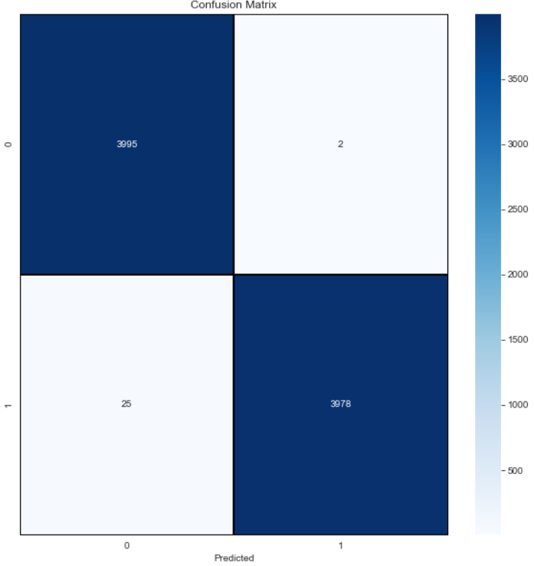
Confusion matrix
A confusion matrix is a predictive analytics tool. Specifically, it is a table that displays and compares actual values with the model’s predicted values .
Figure 4: Confusion matrix

Slide 10
Confusion matrix
True Positive (TP): True positive represents the value of correct predictions of positives out of actual positive cases. Out of 4003 actual positives, 3978 are correctly predicted positive. Thus, the value of true positive is 3978.
False Positive (FP): It represents the value of incorrect positive predictions. The value represents the number of negatives(out of 3997) which gets falsely predicted a positive. Out of 3997 actual negatives, 2 is falsely predicted as positive. Thus the value of false positive is 2.
True Negative (TN): True negative represents the value of correct prediction of negatives out of actual negative cases. Out of 3997 actual negatives , 3995 are corrected predicted as negatives. The value of true negatives is 3995.
False Negative (FN): False Negative represents the value of incorrect negative predictions. This value represents the number of actual positives (out of 4003) which gets falsely predicted as negatives. Out of 4003 actual positives, 25 is incorrectly predicted as negatives. Thus, the value of False Negative is 25

Slide 11
Precision
It represents the model's ability to correctly predict the positives out of all the positive prediction it made. It represents the ratio between the number positive samples correctly classified to the total number of samples classified as positive (either correctly or incorrectly).
Precision score = TP/(TP+FP)
= (3978/(2+3978)
= 1.00

Slide 12
Recall
Model recall score represents the model's ability to correctly predict the positives out of actual positives. The recall is calculated as the ratio of the true positives to the actual positives
Recall score = TP/(TP+FN)
= 3978/(3978+25)
= 0.99

Slide 13
Accuracy score
It represents the model's ability to correctly predict both the positives and negatives out of all the predictions.
Accuracy score = (TP+TN)/(TP+FP+TN+FN)
= (3978+3995) / (3978 + 25 + 3995 + 2)
= 1.00

Slide 14
F1-SCORE
It represents the model's score as a function of precision and recall score. The F1-score is a way of combining the precision and recall of the model, It is also known as the harmonic mean of the model's precision and recall
F1-score = 2 X Precision score X Recall score / (Precision score + Recall score)
= (2 X 1.00x0.99) /( 1.00+ 0.99)
= 0.99

Slide 15
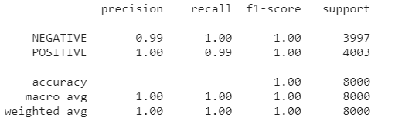
Classification Report
Classification report gives us a summary table containing precision, recall, F1-score and makes it easy for us to observe which class performs better
Figure 5: Classification report

Slide 16
References
[1] Özgenel, Ç. F. (2019, 07 23). Mendeley Data. Retrieved from Concrete Crack Images for Classification: https://data.mendeley.com/datasets/5y9wdsg2zt/2
[2] SCIENTIFIC, G. (2019, August 17). Evaluating Cracking in Concrete: Procedures. Retrieved from GIATEC: https://www.giatecscientific.com/education/cracking-in-concrete-procedures/
[3] Vadapalli, P. (2021, February 25). Image Classification in CNN: Everything You Need to Know. Retrieved from upgradeblog: https://www.upgrad.com/blog/image-classification-in-cnn/
[4] Wikipedia. (2021, February 13). 2013 Dhaka garment factory collapse. Retrieved from Wikipedia: https://en.wikipedia.org/wiki/2013_Dhaka_garment_factory_collapse
[5] GreekForGreek. (2020, May 18). Keras.Conv2D Class. Retrieved from GreekForGreek: https://www.geeksforgeeks.org/keras-conv2d-class/
[6] Lathiya, A. (9, September 5). Numpy Argmax: How To Use Np Argmax() Function In Python. Retrieved from https://appdividend.com/2020/03/28/python-numpy-argmax-function-example/
[7] ScienceDirect. (2021). Convolutional Layer. Retrieved from ScienceDirect : https://www.sciencedirect.com/topics/engineering/convolutional-layer

